Slide 1



Phishing Awareness Training
Cyber Security Internship Project.
CodeAlpha.
Prepared by: Soham Shivram Haldankar.

Slide 2
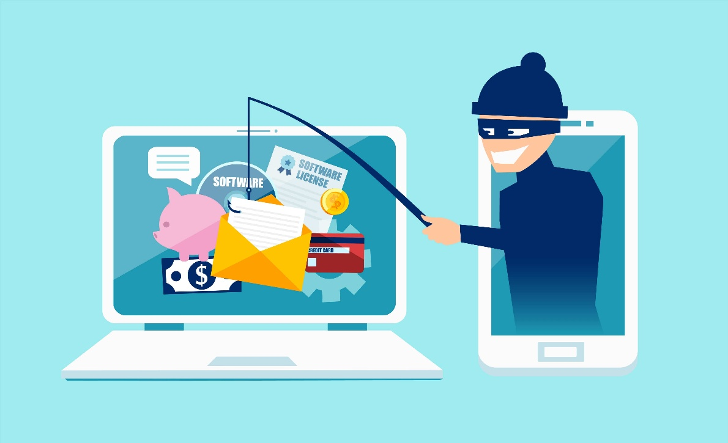
What is Phishing?
Phishing is a cyber attack where attackers trick users into revealing sensitive information such as passwords, banking details, OTPs, or personal information by pretending to be a trusted source.
Examples:-
Fake bank emails.
Fake login pages.
Fraudulent messages.

Slide 3
How Phishing Works:-
Attacker:-The cybercriminal creates a plan to trick people into revealing sensitive information.
↓
Fake Email/SMS:-The attacker sends a message that looks genuine (bank, company, or service) to gain the victim's trust.
↓
Victim Clicks Link:-The victim believes the message is real and clicks the provided malicious link.
↓
Fake Website:- The link opens a website that closely resembles the legitimate website to fool the victim.
↓
Credentials Stolen:- When the victim enters their username, password, or other details, the information is sent directly to the attacker.
Flow: Attacker → Fake Email/SMS → Victim Clicks Link → Fake Website → Credentials Stolen.

Slide 4
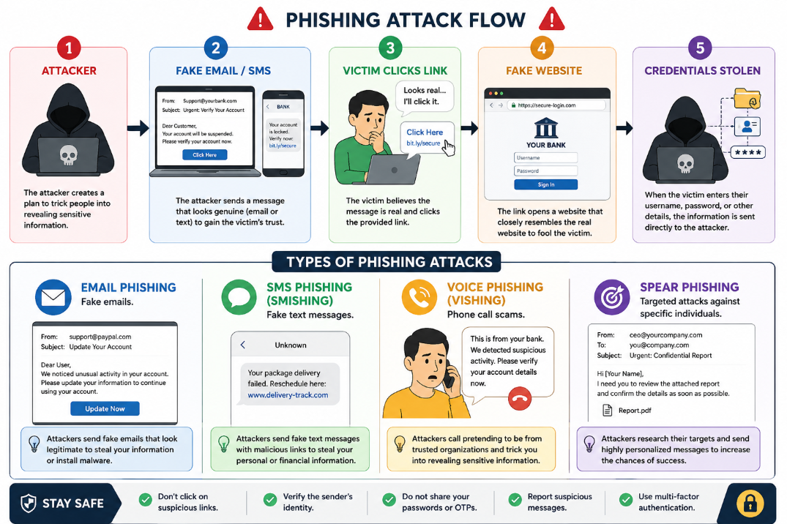
Types of Phishing
Include:
Email Phishing:-
Fake emails.
SMS Phishing (Smishing):-
Fake text messages.
Voice Phishing (Vishing):-
Phone call scams.
Spear Phishing:-
Targeted attacks against specific individuals.

Slide 5
Example of A Phishing Email:-
For Example You Will Get A Fake Message Like:
Subject: Your Bank Account Will Be Suspended
Dear Customer, Generic greeting
Your account has been flagged.
Click here immediately to verify: Urgency
www.bank-secure-login.xyz Suspicious URL
Failure to verify within 24 hours will result in account suspension.

Slide 6
Fake Websites
Example:-
Real:
amazon.in
Fake:
amaz0n-security.com
As You Can See There are Following Mistakes In Above Example :-
Misspellings
Extra words
Fake domains

Slide 7
Social Engineering
Social engineering is the psychological manipulation of people to perform actions or reveal confidential information.
Examples:
Fake IT support
Fake HR calls
Lottery scams

Slide 8
Warning Signs
Checklist:
✔ Unexpected email.
✔ Urgent language.
✔ Suspicious links.
✔ Grammar mistakes.
✔ Requests for passwords.
✔ Unknown attachments.

Slide 9
Protection Tips
• Verify sender addresses
• Use strong passwords
• Enable Multi-Factor Authentication
• Avoid suspicious links
• Keep software updated
• Report suspicious emails

Slide 10
Real World Example
Google and Facebook BEC Scam (Business Email Compromise)
Brief Explanation:
Fraudsters impersonated a legitimate vendor by sending fake business emails.
Employees believed the emails were genuine and transferred millions of dollars to the scammers' bank accounts.
The scam caused losses of over $100 million before it was discovered.
This case demonstrates how phishing and email fraud can successfully target even large organizations like Google and Facebook.
Key Lesson: Always verify payment requests and sender identities before transferring money, even if the email appears to come from a trusted source.

Slide 11
Quiz:-
Question 1
What is phishing?
Antivirus B) Fraud attempt to steal information ✅ C) Firewall D) Encryption
Question 2
Which is a warning sign?
HTTPS only B) Strong password C) Urgent request for credentials ✅ D) MFA
Question 3
What should you do before clicking links?
A) Click immediately B) Verify sender and URL ✅ C) Disable antivirus D) Share password

Slide 12



Thank You.
Stay Alert.
Stay Secure.

